Slide 1

Introduction to E1DISP
Lake Examples
River Examples

Slide 2
Lake Example
Example 2.1

Slide 3
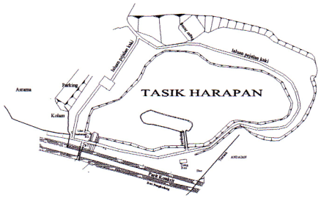
Example 2.1
Consider Lake Harapan in USM with a surface area of 10000 m² and a mean depth of 1 m. This small lake has a uniformly mixed content containing 80000 g of pollutant that decays at the rate of 0.5 d⁻¹. The concentration of the pollutant in the lake at time t is denoted by C(t).
Form and solve the differential equation for C(t) in mg/L.
Sketch the graph of C(t) when t → ∞.

Slide 4
Example 2.1(b) - Analytical

Slide 5
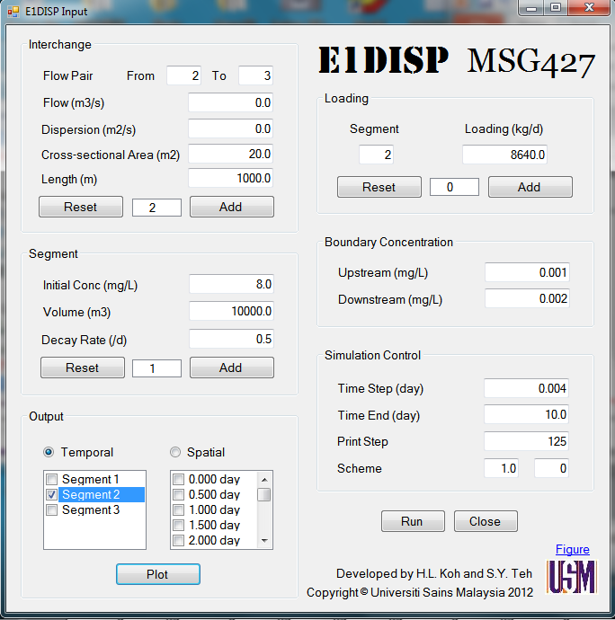
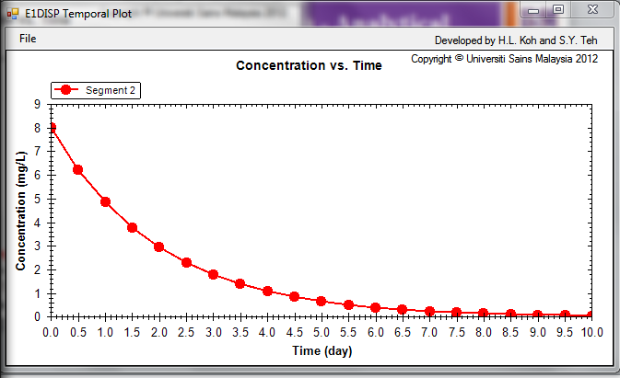
Example 2.1(b) – E1DISP

Slide 6
River Examples
Examples 3.1 – 3.3

Slide 7
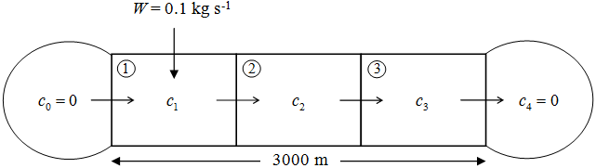
Example 3.1 - Summary
A = 20 m² L = 3000 m u = 0.1 m/s
E = 0.0 m²/s Δx = 1000 m W = 0.1 kg/s
k = 10⁻⁴ s⁻¹

Slide 8
Example 3.1 – Analytical Solution

Slide 9
Example 3.2 - Summary
A = 20 m² L = 3000 m u = 0.1 m/s
E = 0.2 m²/s Δx = 1000 m W = 0.1 kg/s
k = 10⁻⁴ s⁻¹

Slide 10
Example 3.2 – Analytical Solution

Slide 11
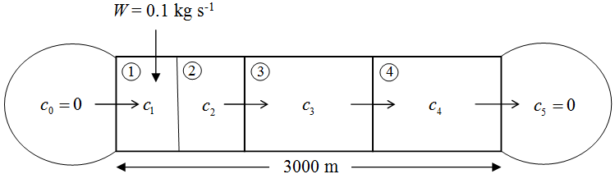
Example 3.3 - Summary
A = 20 m² L = 3000 m u = 0.1 m/s
E = 0.0 m²/s Δx = 1000 m W = 0.1 kg/s
k = 10⁻⁴ s⁻¹

Slide 12
Example 3.3 – Analytical Solution

Slide 13
Thank you
Presented by
Assoc. Prof. Dr. Teh Su Yean | School of Mathematical Sciences

